Slide 1
Visit https://bit.ly/birn-data, click scraping
Scraping!
stealing data from the internet for fun
(and investigations!)

Slide 2
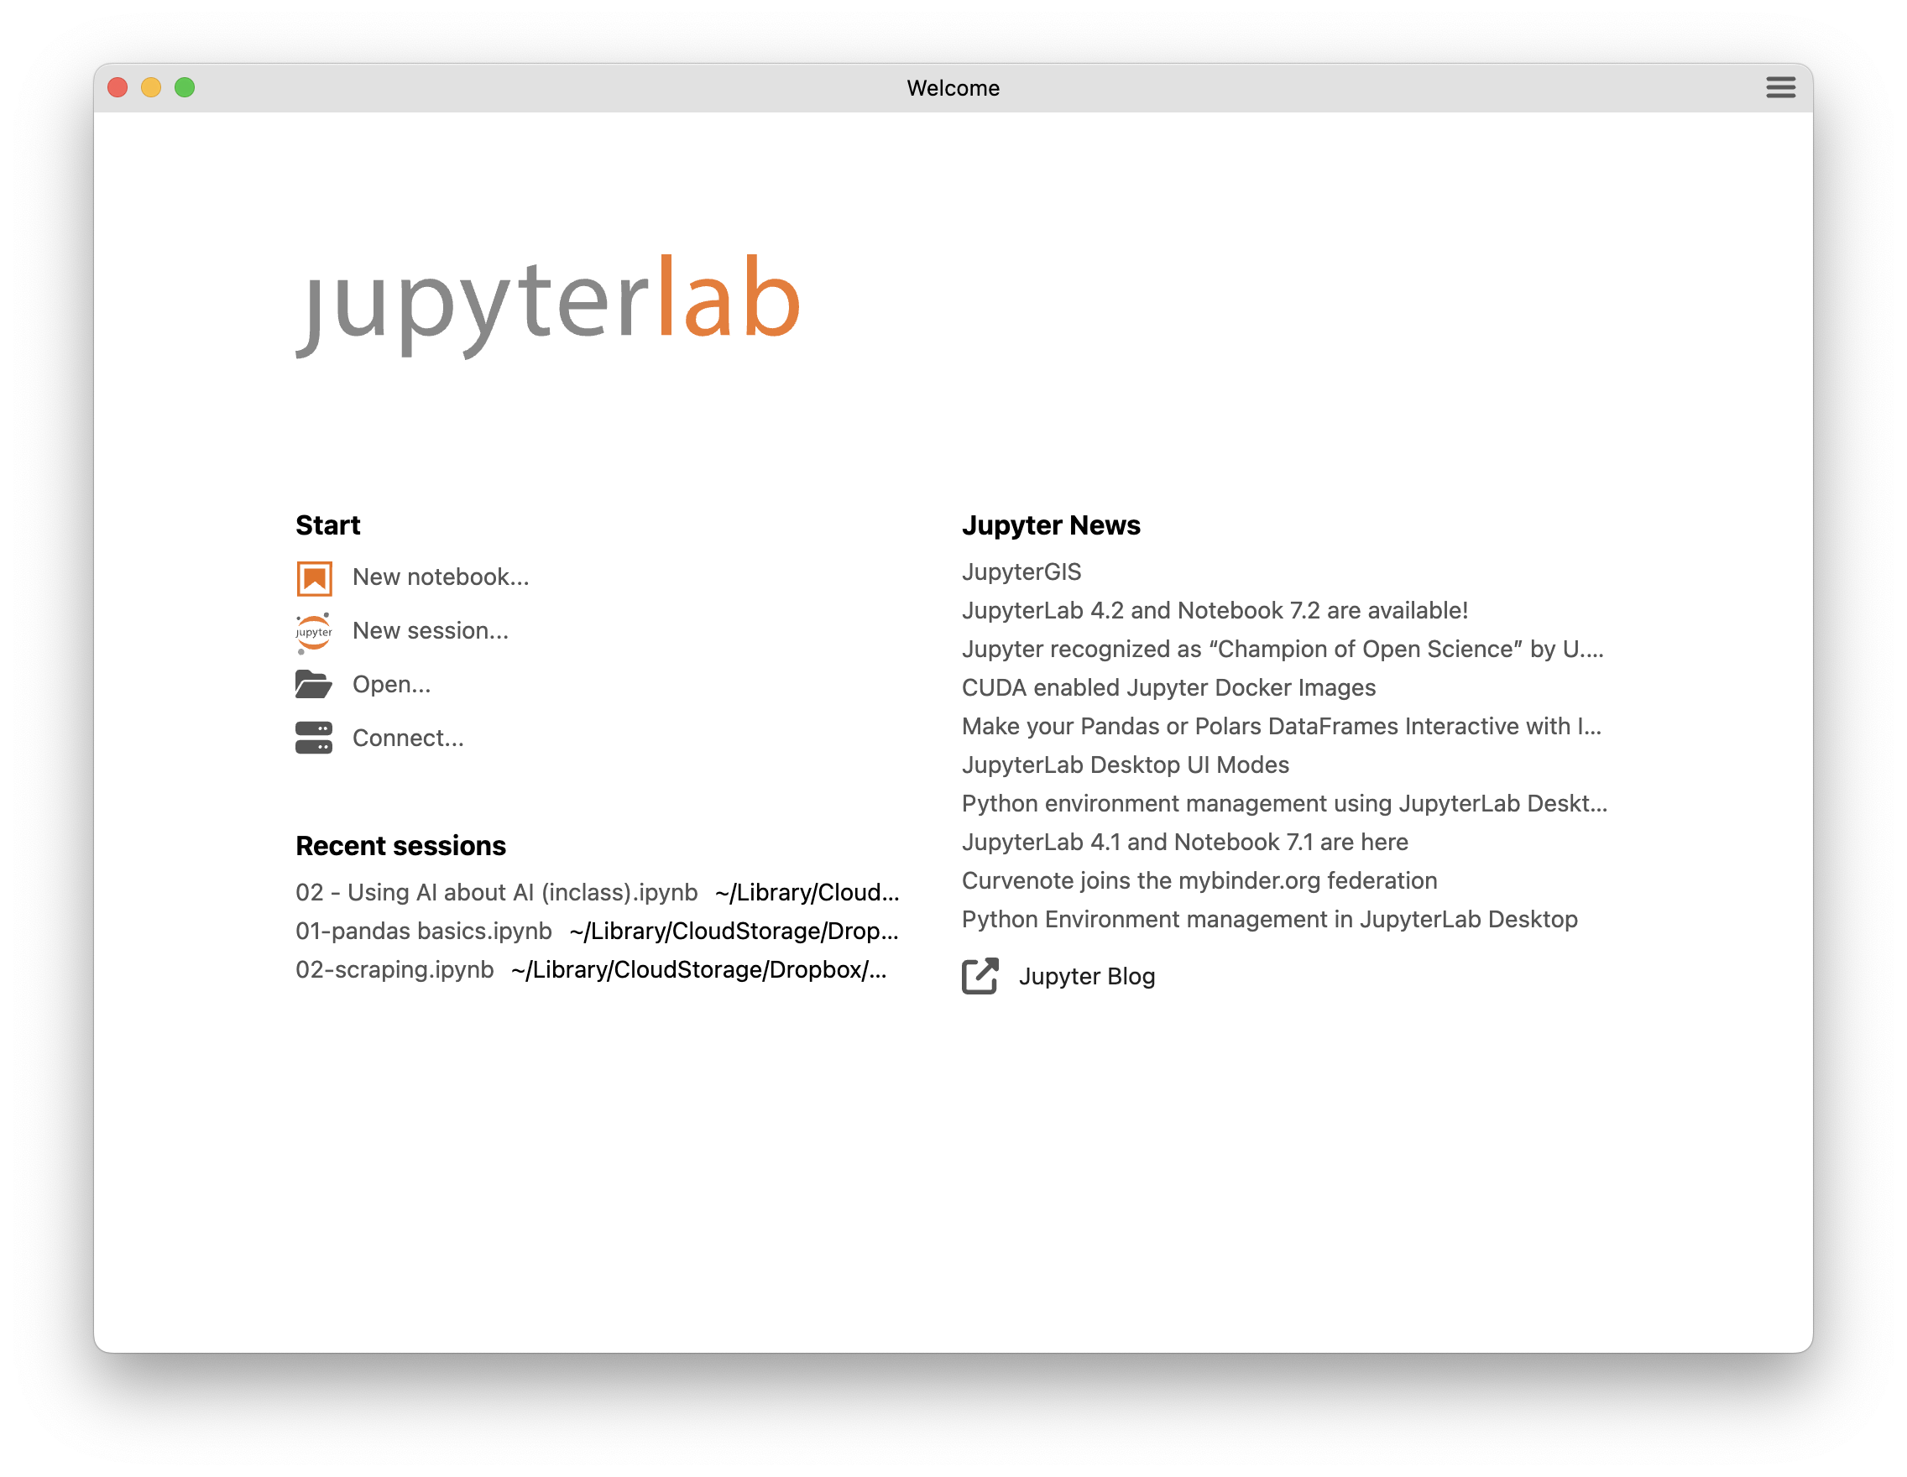
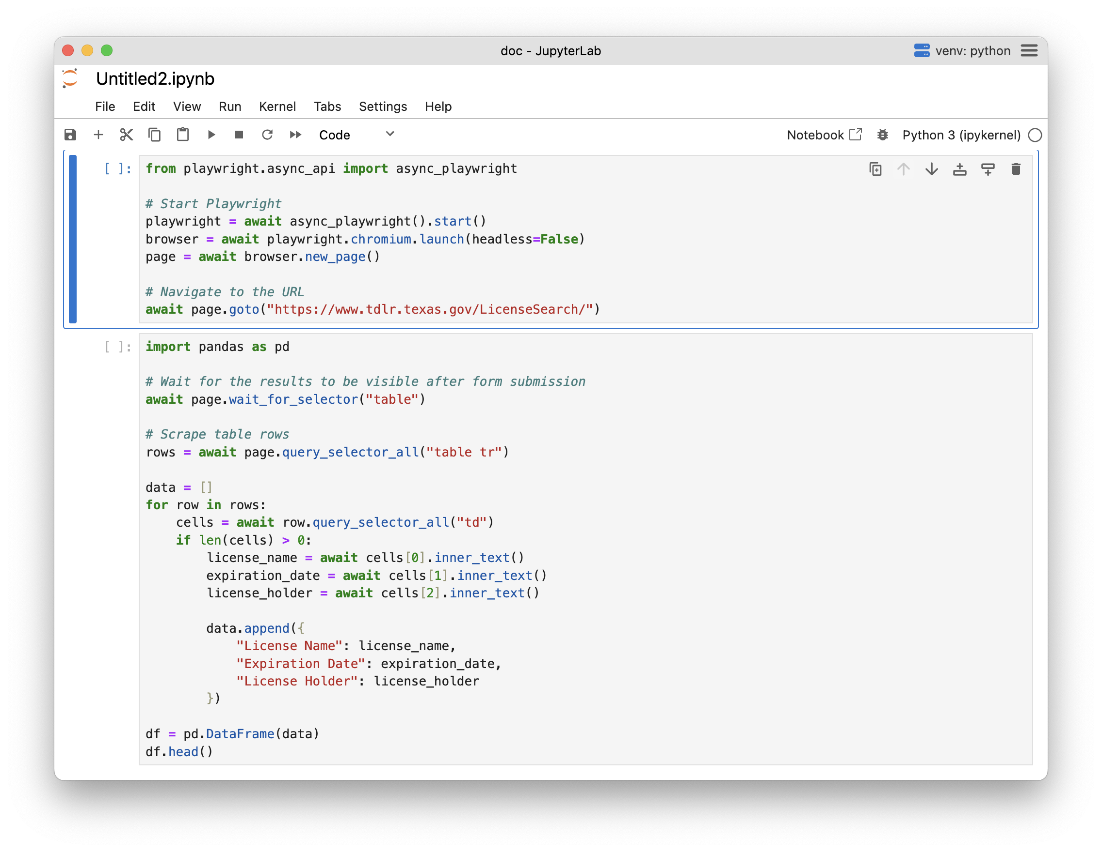
Visit https://bit.ly/birn-data, click scraping
Download, install and open JupyterLab

Slide 3
Visit https://bit.ly/birn-data, click scraping
HTML
the language that all web sites are built with

Slide 4
Visit https://bit.ly/birn-data, click scraping
<h1>This is a headline</h1>
<h2>This is a smaller headline</h2>
<h3>And an even smaller headline</h3>

Slide 5
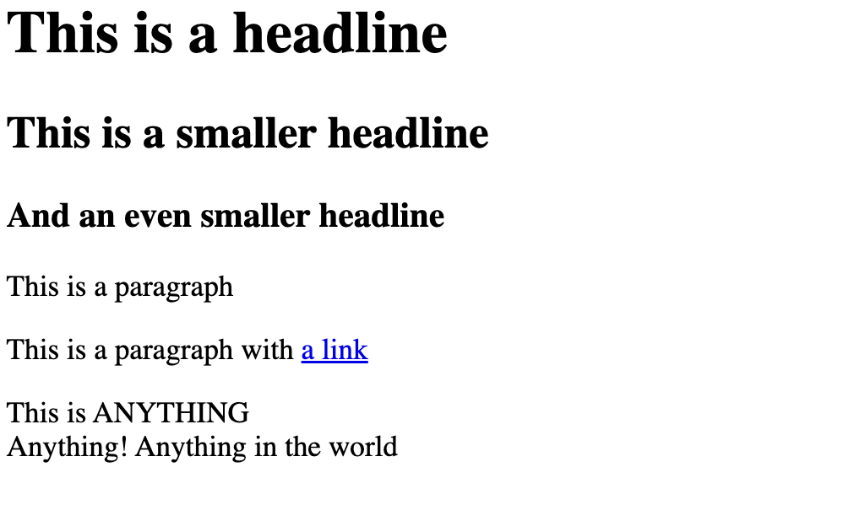
Visit https://bit.ly/birn-data, click scraping

Slide 6
Visit https://bit.ly/birn-data, click scraping
<h1>This is a headline</h1>
<h2>This is a smaller headline</h2>
<h3>And an even smaller headline</h3>
<p>This is a paragraph</p>
<img src=“photo.jpg”>
<p>This is a paragraph with
<a href=“google.com”>a link</a></p>
<div>This is ANYTHING</div>
<div>Anything! Anything in the world</div>

Slide 7

Visit https://bit.ly/birn-data, click scraping
(imagine there’s a photo)

Slide 8
Visit https://bit.ly/birn-data, click scraping
<h1>An incredible story</h1>
<p>By J. Soma</p>
<p>This is the start of the story.</p>
<p>It is an amazing story!</p>
<p>”It’s incredible,” said the source.</p>
<p>An editor agreed: “it’s true!”</p>
<p>Additional reporting by Mulberry the fat mean cat</p>
<p>Edit: An earlier version said “Jonathan” Soma</p>

Slide 9
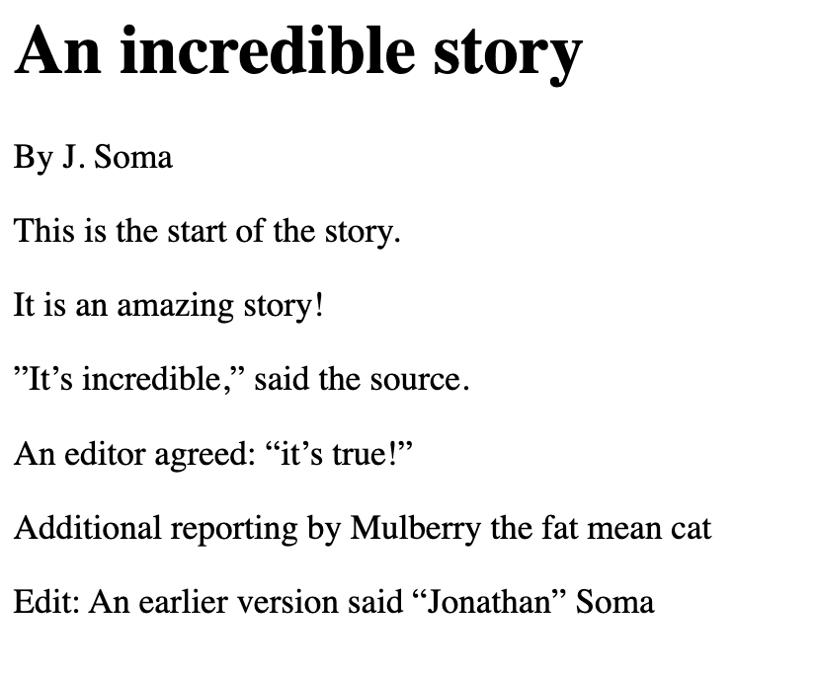
Visit https://bit.ly/birn-data, click scraping

Slide 10
Visit https://bit.ly/birn-data, click scraping
<h1>An incredible story</h1>
<p>By J. Soma</p>
<p>This is the start of the story.</p>
<p>It is an amazing story!</p>
<p>”It’s incredible,” said the source.</p>
<p>An editor agreed: “it’s true!”</p>
<p>Additional reporting by Mulberry the fat mean cat</p>
<p>Edit: An earlier version said “Jonathan” Soma</p>

Slide 11
Visit https://bit.ly/birn-data, click scraping
<h1>An incredible story</h1>
<p id=“byline”>By J. Soma</p>
<p>This is the start of the story.</p>
<p>It is an amazing story!</p>
<p>”It’s incredible,” said the source.</p>
<p>An editor agreed: “it’s true!”</p>
<p class=“additional”>Additional reporting by Mulberry the fat mean cat</p>
<p class=“correction”>Edit: An earlier version said “Jonathan” Soma</p>

Slide 12
Visit https://bit.ly/birn-data, click scraping
<h1>An incredible story</h1>
<p id=“byline”>By J. Soma</p>
<p>This is the start of the story.</p>
<p>It is an amazing story!</p>
<p>”It’s incredible,” said the source.</p>
<p>An editor agreed: “it’s true!”</p>
<p class=“additional”>Additional reporting by Mulberry the fat mean cat</p>
<p class=“correction”>Edit: An earlier version said “Jonathan” Soma</p>

Slide 13
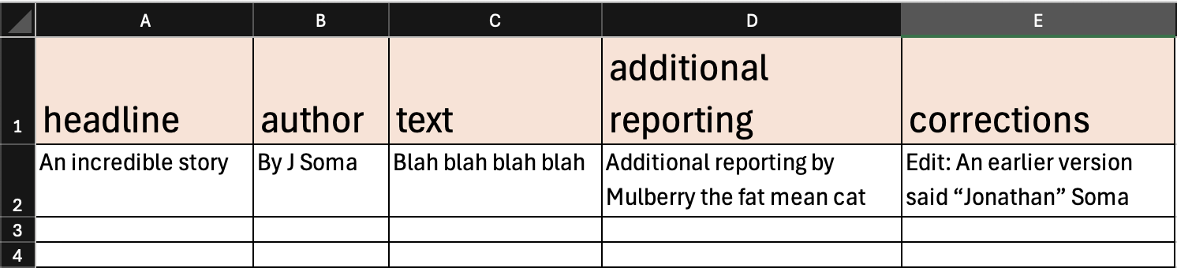




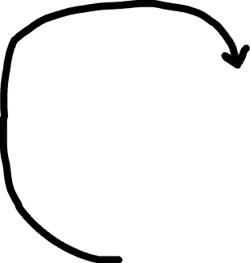
Visit https://bit.ly/birn-data, click scraping
<p>
id=“byline”
<h1>
<h1>An incredible story</h1>
<p id=“byline”>By J. Soma</p>
<p>This is the start of the story.</p>
<p>It is an amazing story!</p>
<p>”It’s incredible,” said the source.</p>
<p>An editor agreed: “it’s true!”</p>
<p class=“additional”>Additional reporting by Mulberry the fat mean cat</p>
<p class=“correction”>Edit: An earlier version said “Jonathan” Soma</p>
class=“additional”
class=“correction”

Slide 14
Visit https://bit.ly/birn-data, click scraping
Let’s see it on the internet!

Slide 15
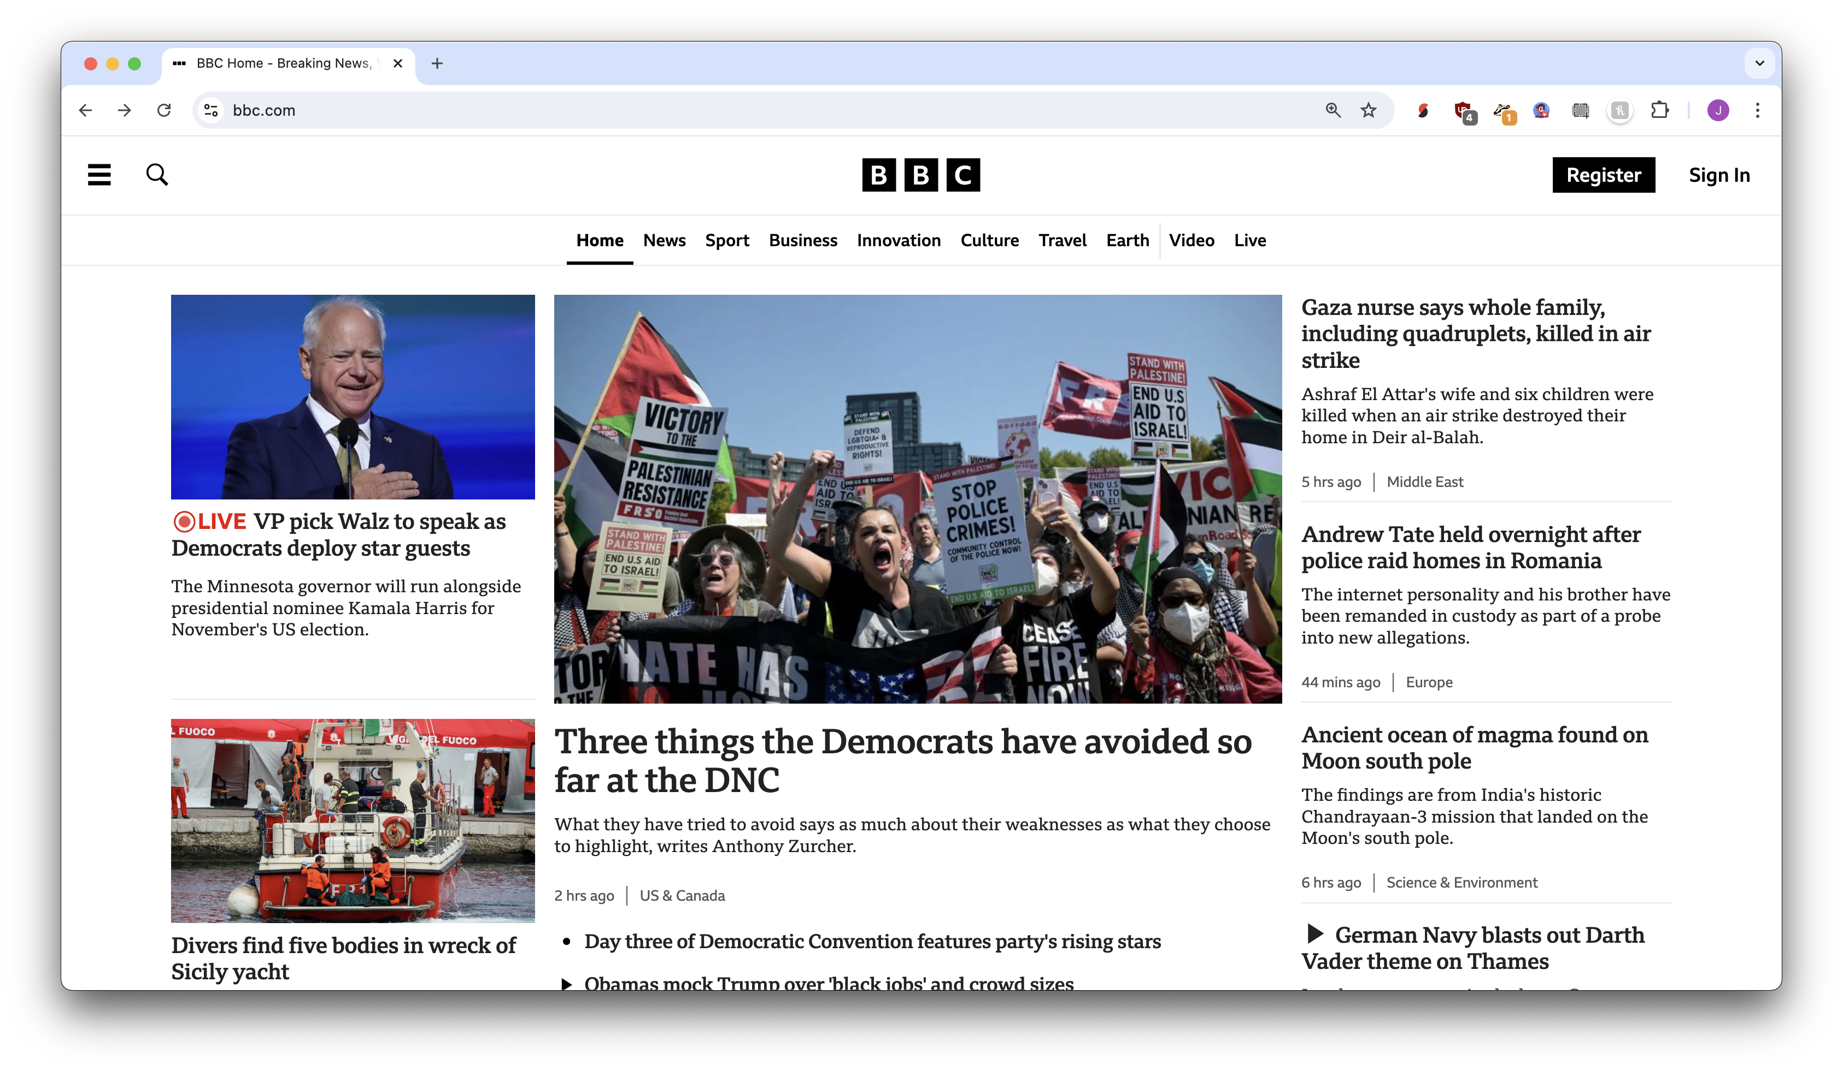
What will be a row in our spreadsheet?

Slide 16







Slide 17
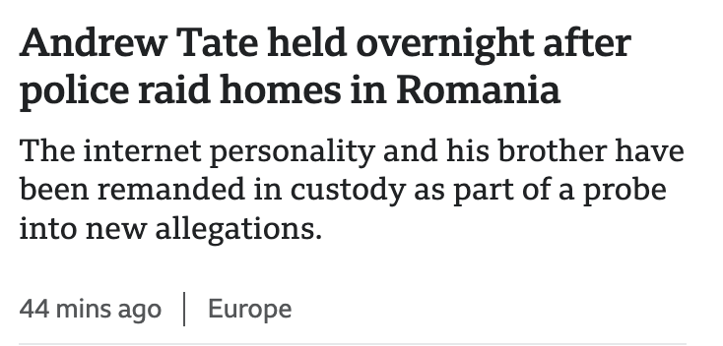



What will be a column of data?

Slide 18
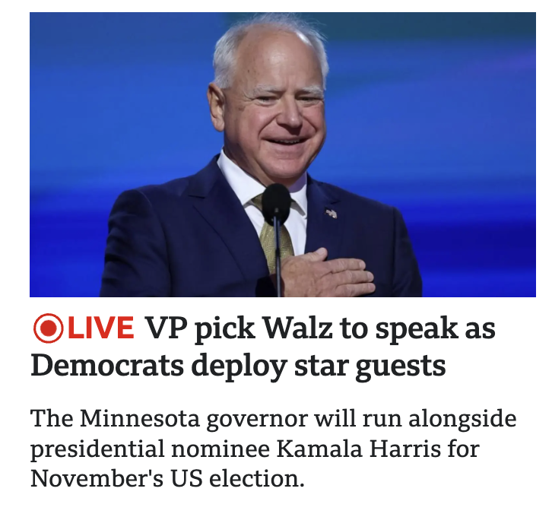



Slide 19
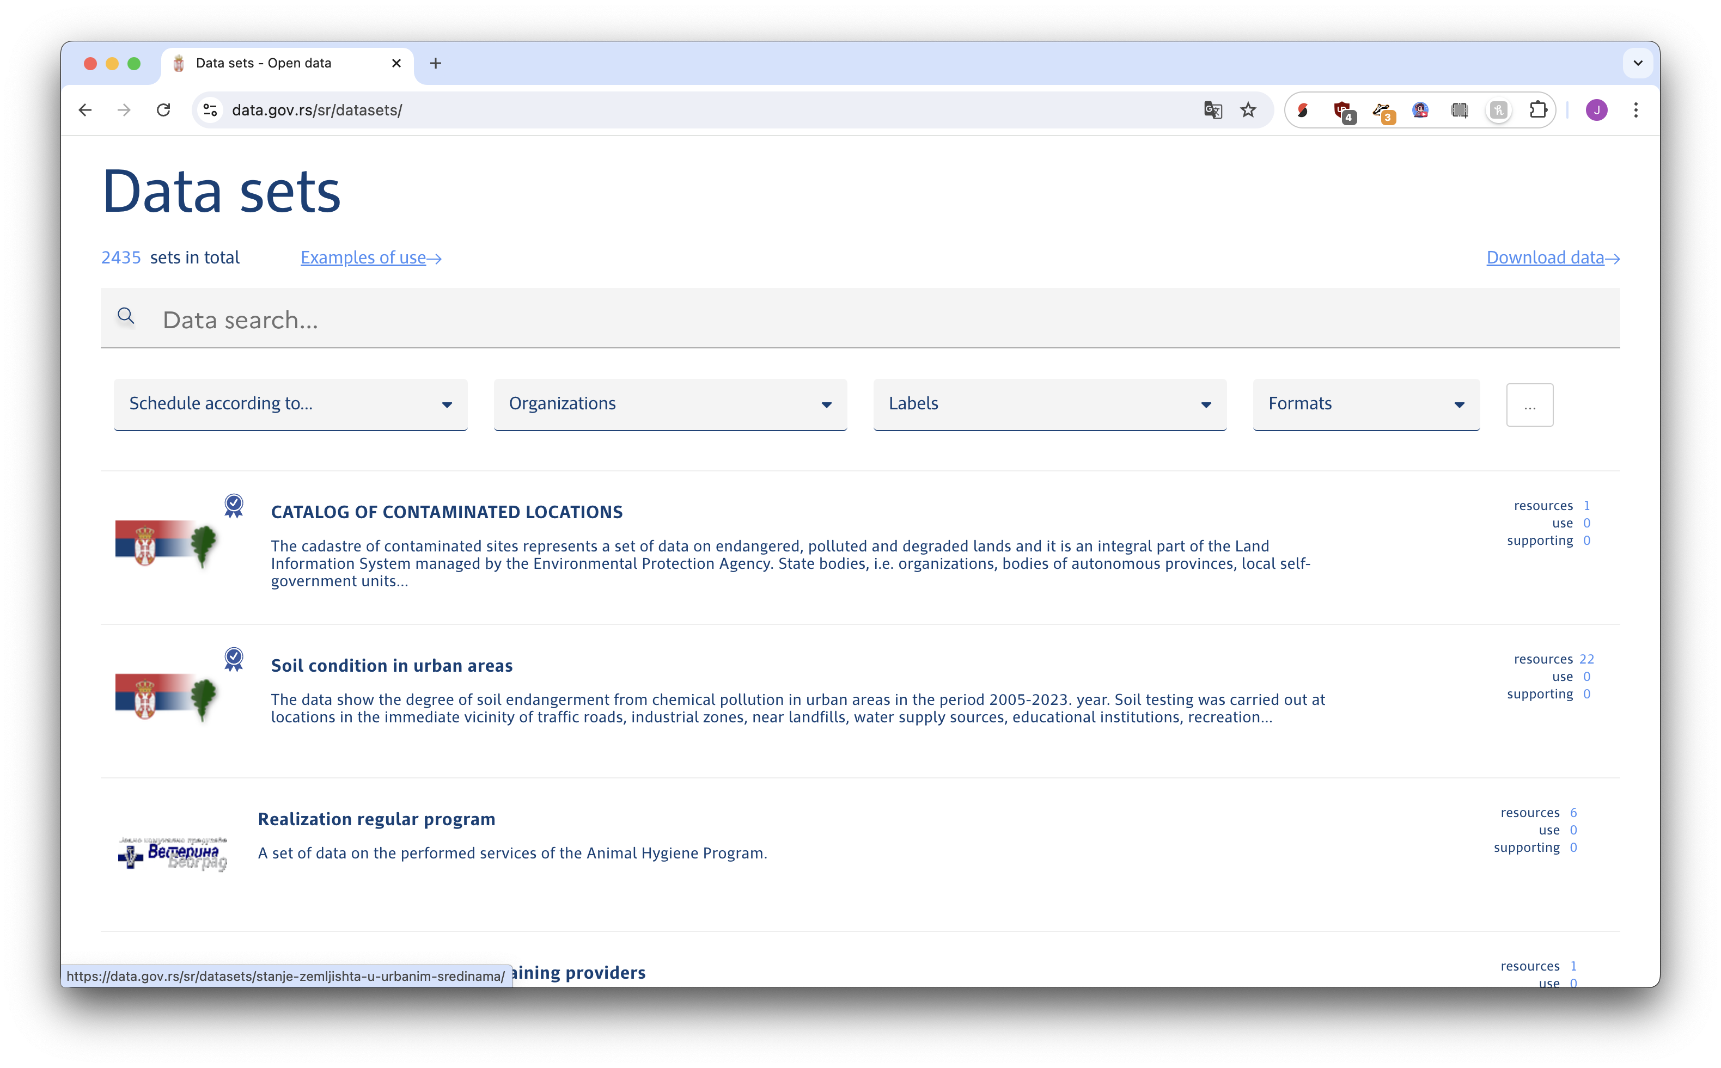
What will be a row in our spreadsheet?

Slide 20




Slide 21
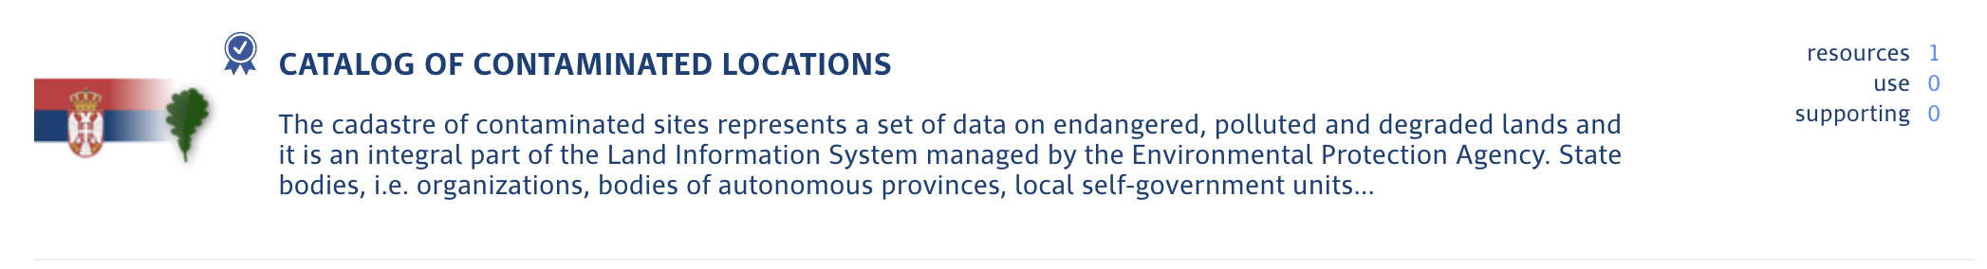

What will be a column of data?

Slide 22
Visit https://bit.ly/birn-data, click scraping
Computers don’t see like us (usually), we need to see
HTML code

Slide 23
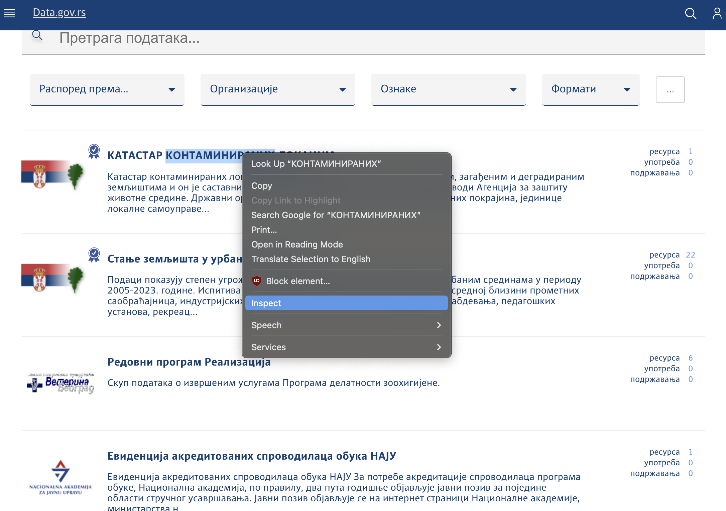
Right click (or command+click) and Inspect

Slide 24
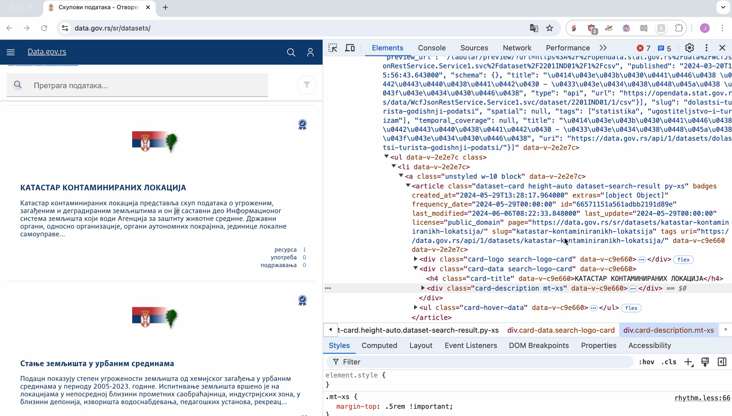

Find the HTML for our “row”
Mouse/click around
METHOD ONE

Slide 25
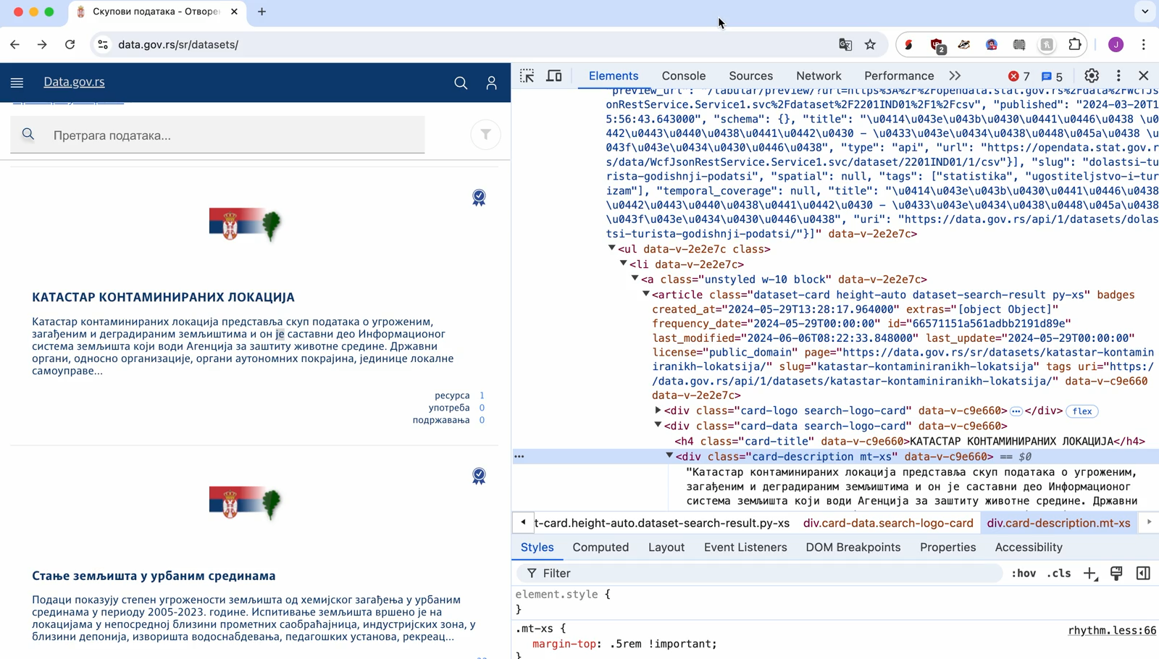



Find the HTML for our “row”
Click this
Search + click here
METHOD TWO

Slide 26
datasets on data.gov.ro
amazon.com search results
Headlines from Nikkei Asia
Now try it.
Wikipedia’s Fictional Big Cats
Sales at Lidl
Anywhere!!!!
List of amphibians from Germany’s Red List Center
School Board Minutes from Grand Island Public Schools in Nebraska

Slide 27
Scraping is just connecting specifics of HTML to columns in your spreadsheet
But we need some software to do that for us!

Slide 28
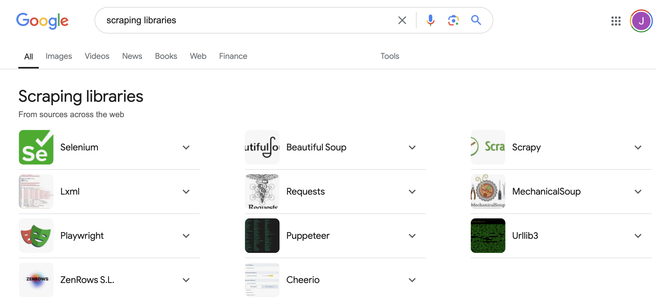
What software?
ask the internet

Slide 29
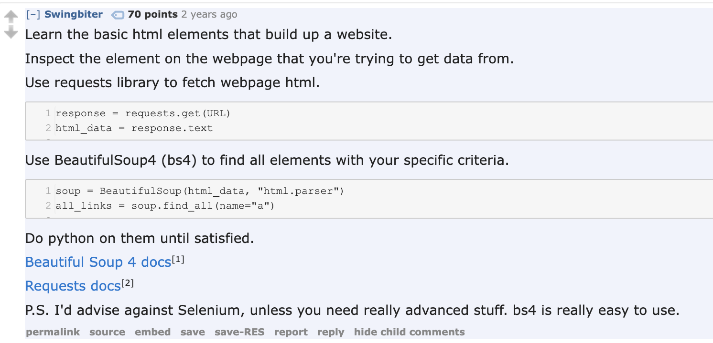
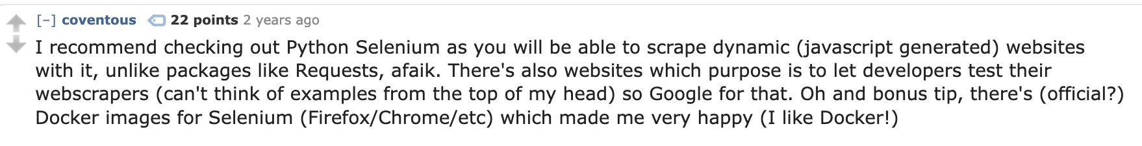
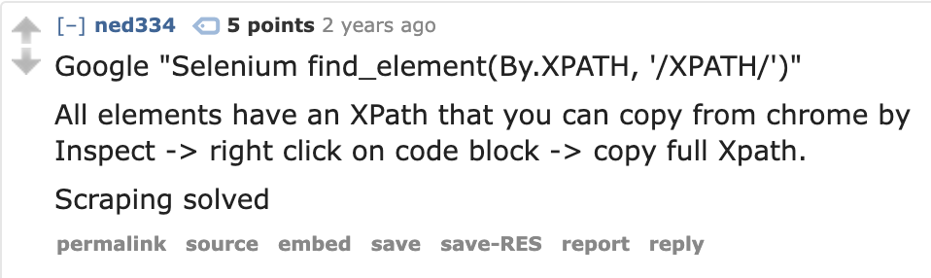
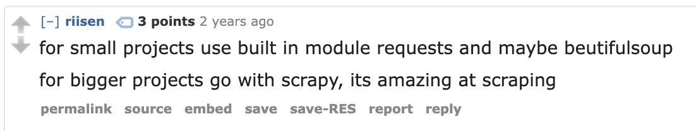
What software?
ask PEOPLE on the internet

Slide 30
Selenium is garbage!
…but BeautifulSoup can’t scrape all sites.

Slide 31
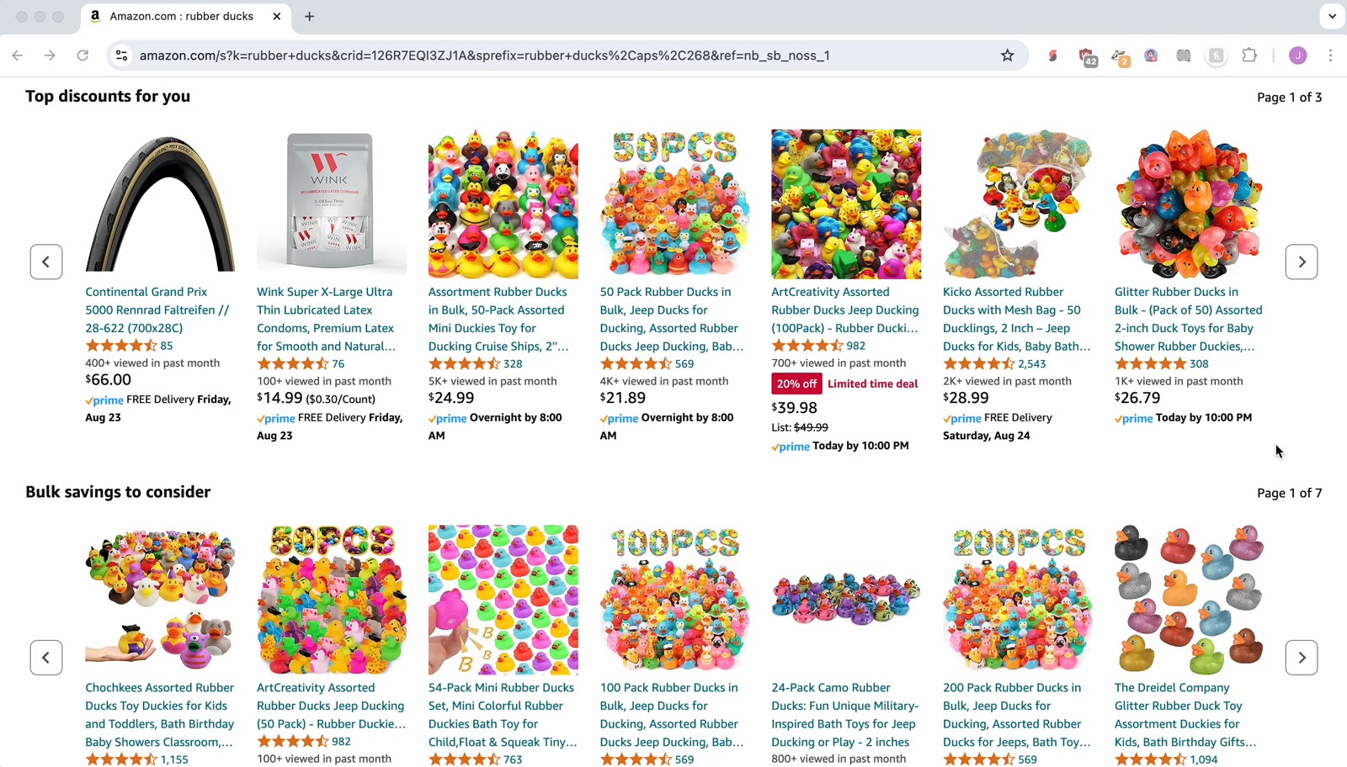
Some sites need interaction

Slide 32
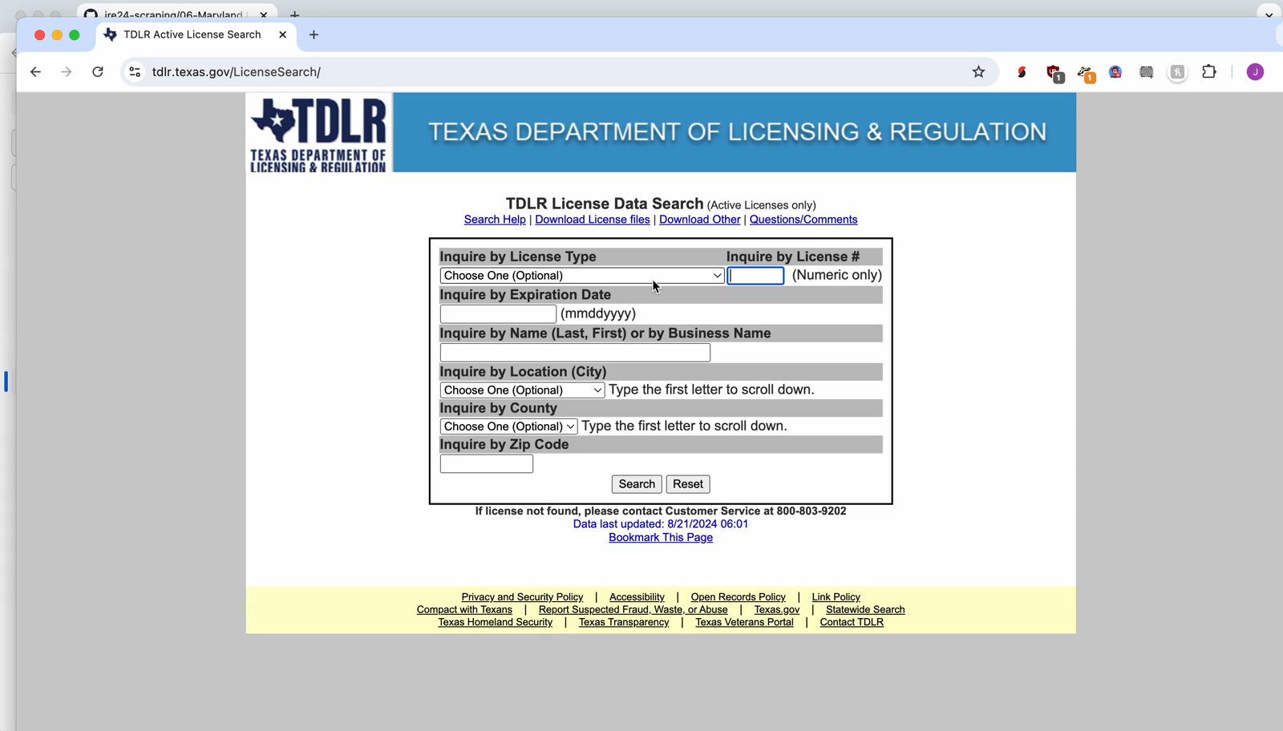
Some sites need interaction

Slide 33
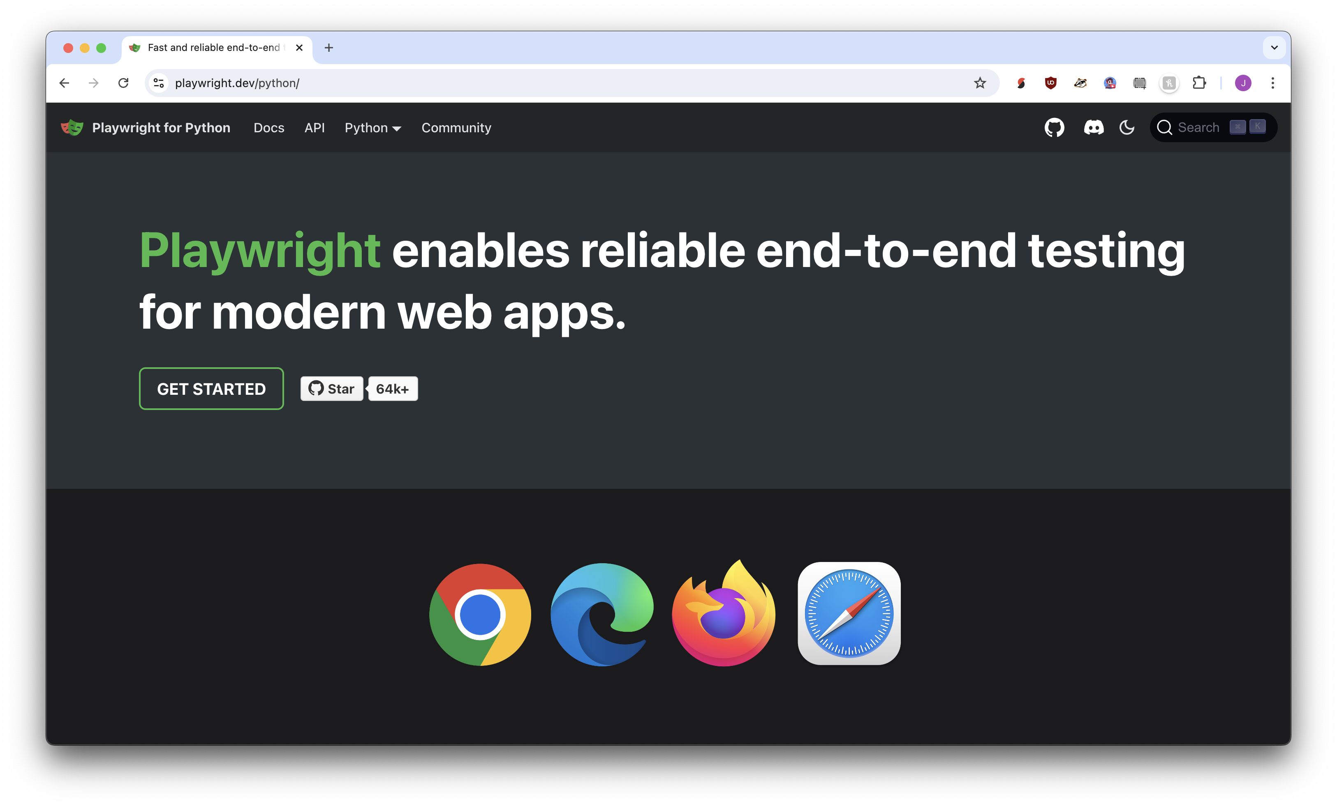
I love Playwright!

Slide 34
Playwright is perfect! But! It’s new, so ChatGPT isn’t very good at it. But! We try.

Slide 35
Playwright + ChatGPT + pasting samples of HTML =
infinite scrapers 🎉

Slide 36
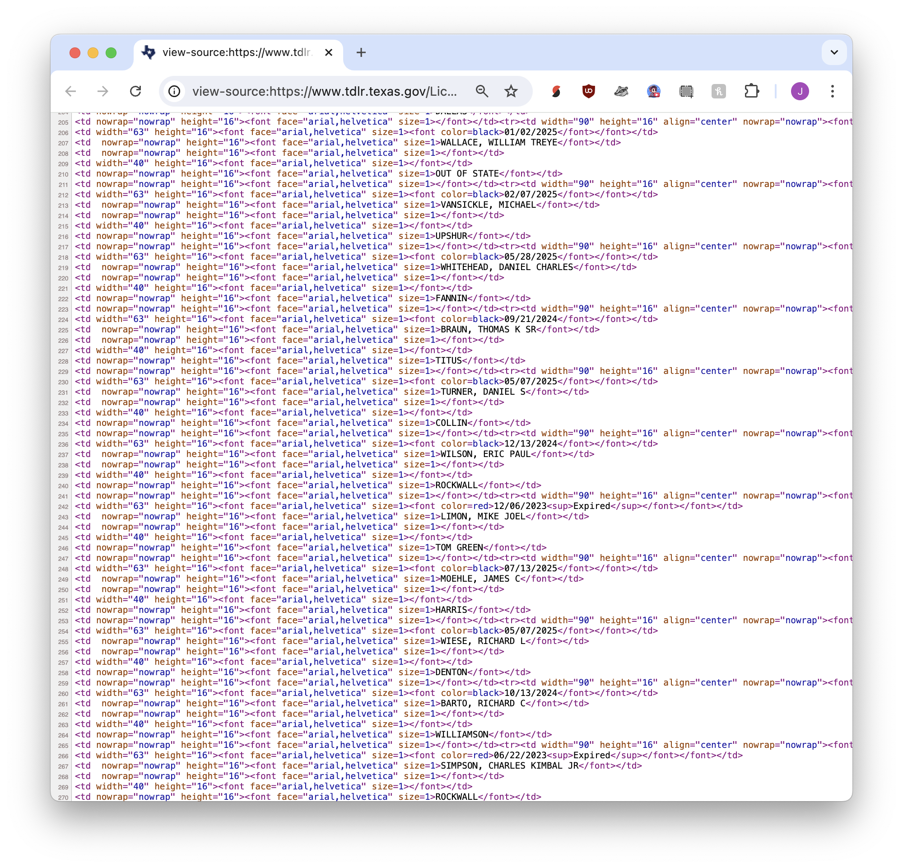

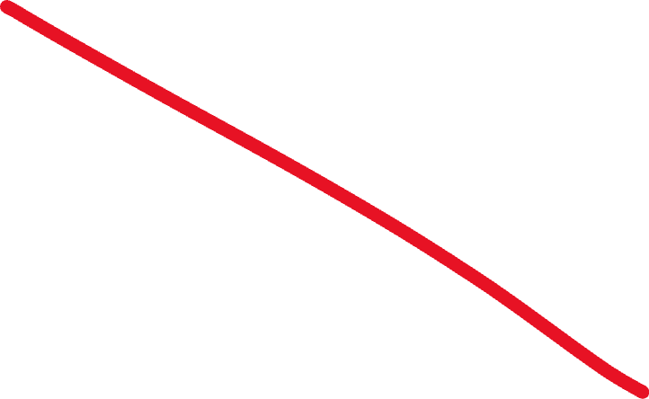
“Write a scraper for these search results:”

Slide 37

“Context window”
<h1>An incredible story</h1>
<p id=“byline”>By J. Soma</p>
<p>This is the start of the story.</p>
<p>It is an amazing story!</p>
<p>”It’s incredible,” said the source.</p>
<p>An editor agreed: “it’s true!”</p>
<p class=“additional”>Additional reporting by Mulberry the fat mean cat</p>
<p class=“correction”>Edit: An earlier version said “Jonathan” Soma</p>

Slide 38
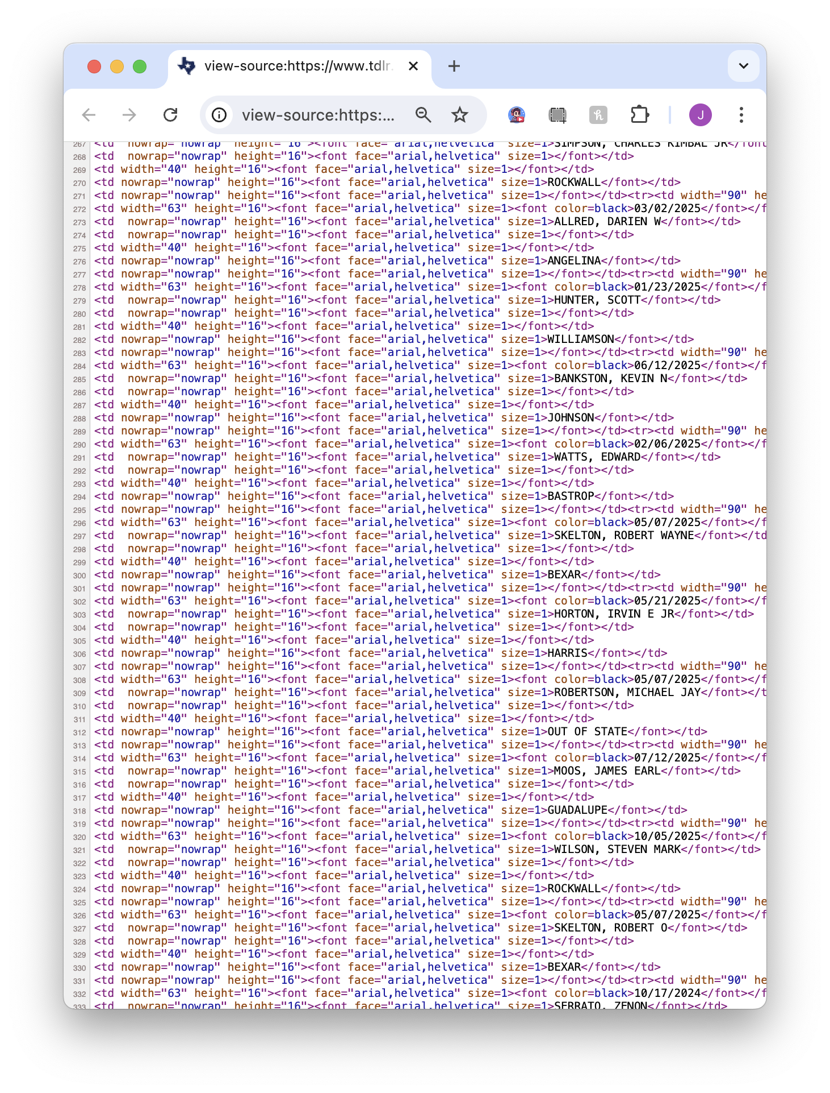
“Context window”

Slide 39
Visit https://bit.ly/birn-data, click scraping
What we might need:
Start URL
Forms to fill out (optional)
“Rows” of our spreadsheet
Pagination/”next” pages (optional)
A magical prompt

Slide 40
https://bit.ly/birn-data
Open a new Jupyterlab notebook and let’s start scraping!

Slide 41
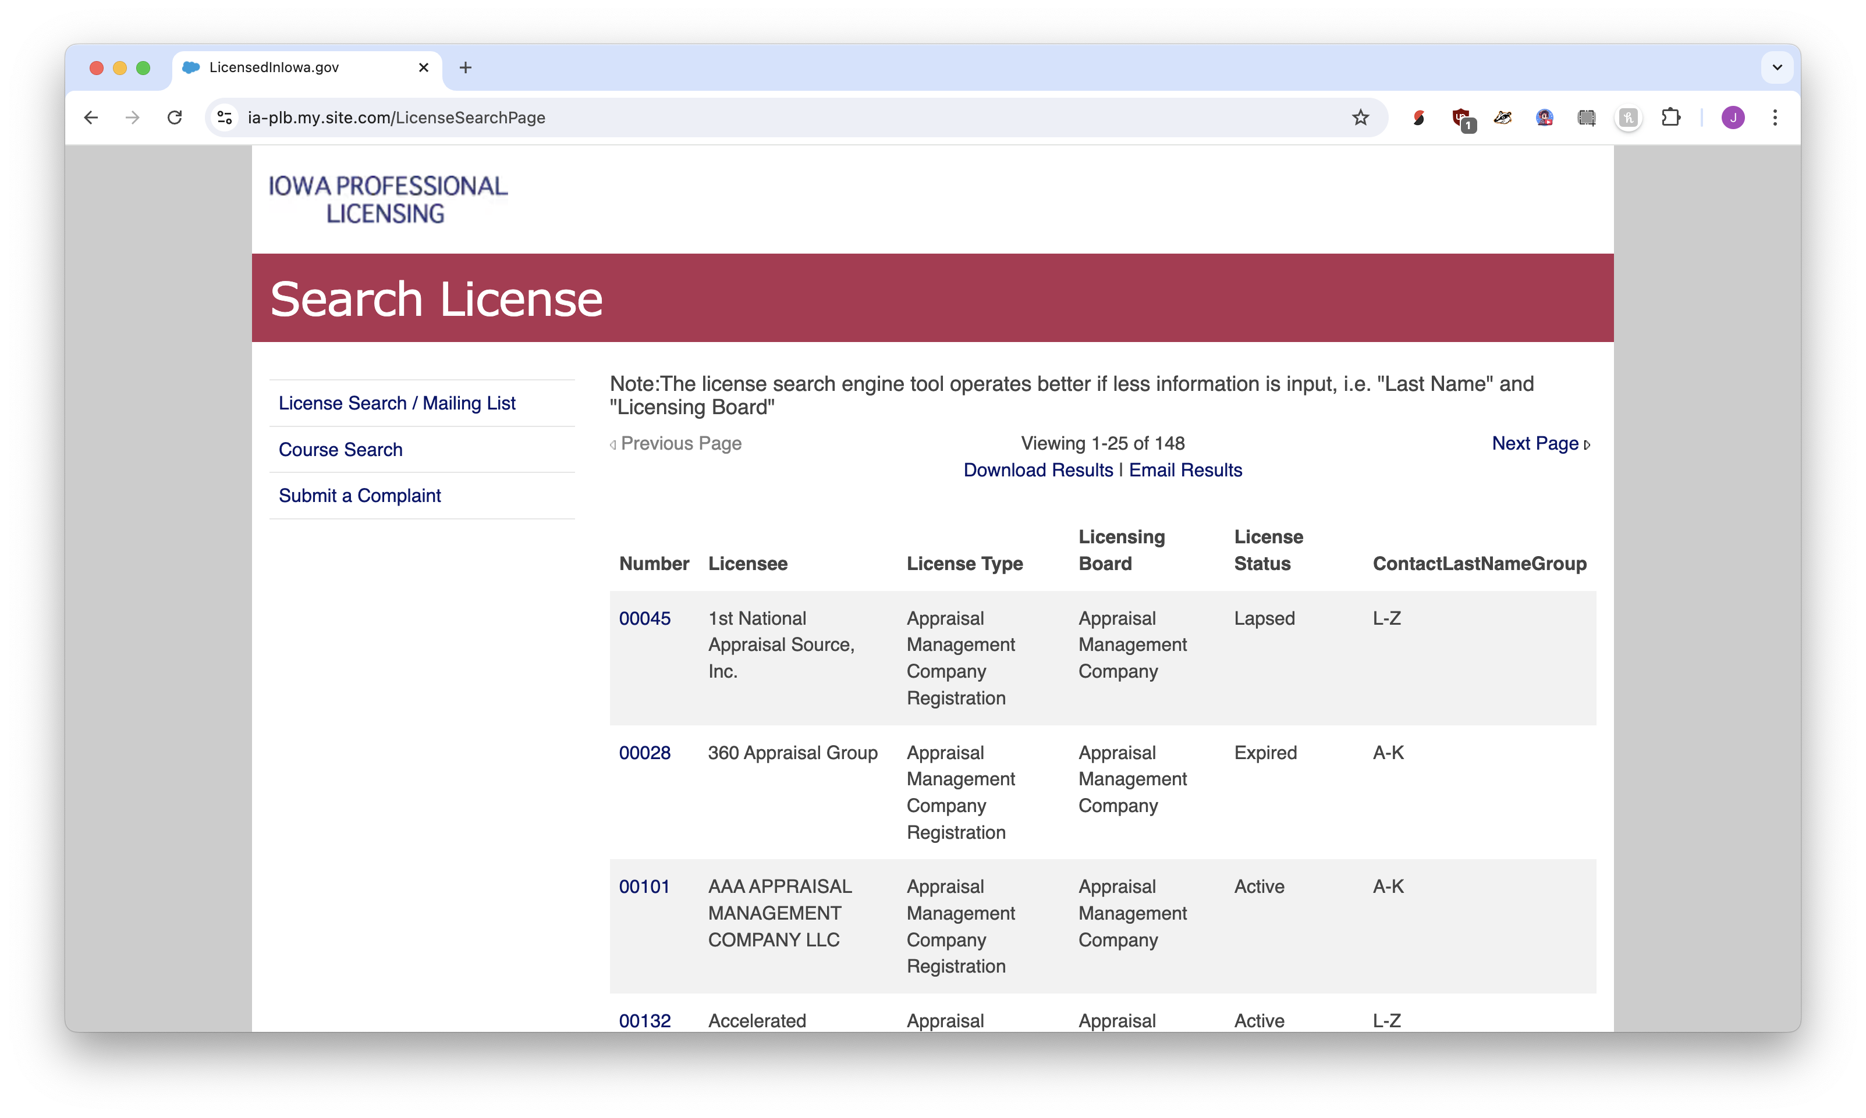
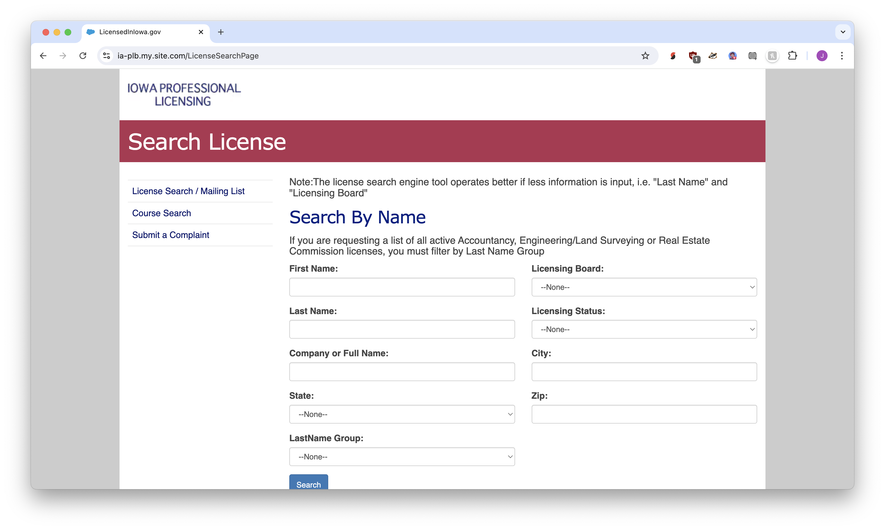

Slide 42
Visit https://bit.ly/birn-data, click scraping
Scraping!
stealing data from the internet for fun
(and investigations!)

